Slide 1

Fighting PoweCO customer churn

Slide 2
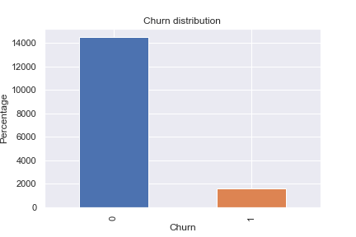
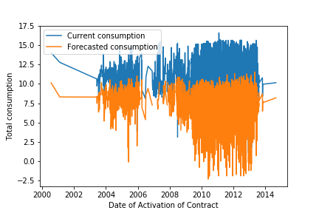
Net margin:
Stayed – 214
Gone - 250
What is churn
10% customer churn
Forecast shows power subscription decrease
Market switching rate: 12% for electricity and 13% for gas in 2015.
Internal tariff switching has remained approximately twice as high.
Switching to another supplier leads to £330 in mid 2015! Average cons – £1 160.
Notes:
Prices fell, while consumption increased on average as a result of colder weather.
91% - save the money
12% - get better customer service

Slide 3
Main reasons
Smart meters roll out by 2020
CMA’s remedies take place: fast & reliable switching, reformed settlements and open prices
Government environmental programmes: wind and solar
New suppliers are entering the market with cheaper fix tariffs
(43 -> 48)
Information campaigns led by Ofgem and DECC and their database
Weather-adjusted domestic consumption fell in 2015 relative to 2014, by 0.9% in gas and 1.3% in electricity.
Switching rates in 2015 rise to 12% for electricity and 13% for gas – 1% more than in 2014.
70% of the customers and 40% microbusinesses are on default expensive variable tariff.
Customers are motivated by price and are most likely to take advantage of competitive fixed-term tariffs.
Source: Ofgem «Retail energy markets»
Notes:
14 new licensed suppliers became active in the domestic segment and nine in the non domestic segment. These new entrants have business models such as not-for-profit, renewable and local supply schemes. The combined market shares of small and medium-sized suppliers in the domestic market also continued to grow, by nearly four percentage points to 14% in March 2016
New entrants now make up 13% of the domestic energy market in both gas and electricity
Energy Switch Guarantee
Energy is almost 10% of overall expenditure for the poorest households
For microbusinesses, our remedies include an order on suppliers to disclose their prices publicly and prohibiting restrictive clauses that lock in customers.

Slide 4
Metrics
15
70% - 100%
12
Negative variables for
consumption and pricing
Missing data
Redundant variables
10%
16,000
30
Churn rate
Clients
Different variables
Notes:
I cannot make conclusions from columns that have a lot of empty cells/ missing values.
I do not know whether an empty cell implies missing value or nothing worth mentioning.
I assumed that the training data is a good representation of the testing data.
For the pricing data, I assumed that empty cells are the same as 0, and that a 0 means that there was no consumption in that time period.
Revenue = Annual var price * Consumption for 12 months + Total fixed price

Slide 5
Data pipeline
1
2
3
4
5
Raw data
Treating missing data,
highly correlated, applying logical rules
Create new variables from existing,
numerise categorical variables
Normalise and standartise numerical variables
Ready for
prediction
Time period: from January to March 2016

Slide 6
Sales channels
 | Customers (%) | Probability of churn
foosdfpfkusacimwkcsosbicdxkicaua | 62.1% | 0.9
lmkebamcaaclubfxadlmueccxoimlema | 17.5% | 0
usilxuppasemubllopkaafesmlibmsdf | 12.2% | 0
ewpakwlliwisiwduibdlfmalxowmwpci | 8.1% | 0.1
sddiedcslfslkckwlfkdpoeeailfpeds | 0.1% | 0
epumfxlbckeskwekxbiuasklxalciiuu | 0.03% | 0
fixdbufsefwooaasfcxdxadsiekoceaa | 0.01% | 0
Need to have a deeper look at this channel:
Widely used
High probability of churn
Collect more data from another channels

Slide 7
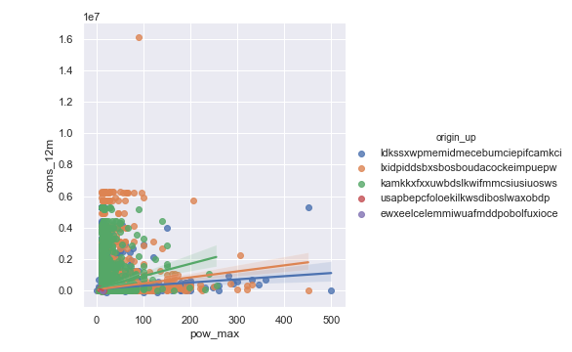
Sales campaigns
Variables Importance by RF:
total_cons_12m
forecast_cons_12m
net_margin
margin_gross_pow_ele
forecast_meter_rent_12m
cons_12m
margin_net_pow_ele
cons_last_month
modification_deferral
forecast_price_energy_p1
contract_long
Notes:
Poor performance of 2 campaigns. Look into issues related to transparency of campaign details, and levels of customer engagement.
Overall subscribed power and electricity consumption: week, do not to spend efforts in increasing subscribed power in order to drive consumption.

Slide 8
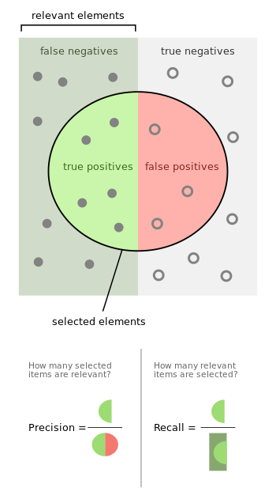
Fitting models
 | Precision (test) | Recall (test) | Accuracy (test) | AUC (test) | Brier (test)
Decision trees | 0.81 | 0.9 | 90% | 0.62 | 0.088
Logistic regression | 0.86 | 0.9 | 90% | 0.63 | 0.088
Random forest | 0.88 | 0.9 | 90% | 0.67 | 0.086
Naive bayes | 0.85 | 0.25 | 24% | 0.60 | 0.511
Bagging | 0.9 | 0.9 | 90.5% | 0.66 | 0.086
AdaBoost | 0.9 | 0.9 | 90.5% | 0.66 | 0.92
Notes:
Decision Tree – easy, a good benchmark
Logistic regression – works well with continuous data
Random Forest - implements many decision trees, smooths overfitting
Naive Bayes – another way of thinking
Bagging – Averages out variances and biases of estimators
AdaBoost – works well with anomalies and outliers, good weighing for classifiers

Slide 9
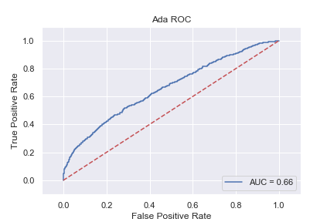
The best model
Variables Importance by RF:
total_cons_12m
forecast_cons_12m
net_margin
margin_gross_pow_ele
forecast_meter_rent_12m
cons_12m
margin_net_pow_ele
cons_last_month
modification_deferral
forecast_price_energy_p1
contract_long
Notes:
Lower consumptions for previous month more likely to result in customers defecting: customers are gradually decreasing consumption before defecting.
"margin_net_pow_ele” – not that surprising because it is likely that customers likely to churn are customers who are being charged a higher price.
“margin_gross_pow_ele” - higher price resulting in customers looking for cheaper alternatives.
High price elasticity can be suspected.
Consumers are making more active choices at the end of fixed-term contracts.

Slide 10
Room for improvement
Check the data
Investigate churn
New propositions
More models
This will lead to better understanding of the situation, improvement of the models.
Win people back: why canceled, how responded to various win-back offers, and how profitable each one who signed on again
Model did not predict churned customers from the dataset. It would be more efficient to distribute discount for all the customers on certain time period.
Try different classes of algorithms for results improvement.
Notes:
Although my classifiers worked well, I would use more classifiers, such as SVM to look at the correlation between training features in an attempt to get a better accuracy on the training data. I can potentially develop a neural network to provide more efficient and accurate results.
On the positive side, the total number of complaints by domestic consumersfell, as reported by suppliers, the Energy Ombudsman and Citizens Advice. This wasmainly because a few suppliers resolved problems with their billing systems, whichbrought the number of complaints back to earlier levels.

Slide 11
Action plan
Billing system
Pricing
Onboarding
Focus on
Reduce the number of complains and improve CX.
Encourage customers to shift consumption to times of the day, introduce pay-as-you-go deals. Use white labels or collective switches.
Use Ofgem database with old clients to acquire new customers based on their energy usage.
Consumers with prepayment meters, consumers in debt, electric heating customers.
70% of customers are still on variable tariff.
Value added services are the key.
Notes:
On the positive side, the total number of complaints by domestic consumers fell, as reported by suppliers, the Energy Ombudsman and Citizens Advice. This was mainly because a few suppliers resolved problems with their billing systems, which brought the number of complaints back to earlier levels.

Slide 12
Q&A

